Slide 1

Exception Handling
BCSC1002 Object Oriented Programming
Notes:
‹#›

Slide 2
Agenda
Introduction to Exception Handling
Exception Handling Techniques
Exception Handling Keywords
BCSC1002 Object Oriented Programming
Notes:
‹#›

Slide 3
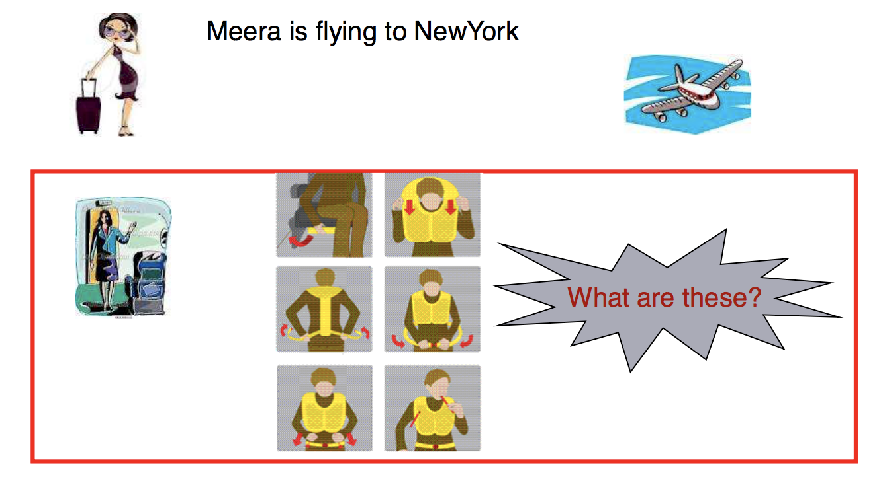
Scenario
BCSC1002 Object Oriented Programming
Notes:
‹#›

Slide 4
Scenario (Contd.).
The previous slide depicts an air hostess giving a demonstration of steps that we have to take as passengers, in case of emergency.
Why this demonstration is important?
Why the air line staff insists on fastening our seat belts?
BCSC1002 Object Oriented Programming
Notes:
‹#›

Slide 5
Scenario (Contd.).
You have to be aware of how to tackle a situation in case of an emergency while you are flying aboard an aircraft.
You have to fasten your seat belts to protect yourself from mishaps that can occur during take off and landing.
This example demonstrates how you have to think in advance the many possibilities of mishaps that can occur and what are the preventive measures that can be taken.
BCSC1002 Object Oriented Programming
Notes:
‹#›

Slide 6
Exception Handling
Similarly, when we write programs as part of an application, we may have to visualize the challenges that can disrupt the normal flow of execution of the code.
Once we know what are the different situations that can disrupt the flow of execution, we can take preventive measures to overcome these disruptions.
In java, this mechanism comes in the form of Exception Handling.
BCSC1002 Object Oriented Programming
Notes:
‹#›

Slide 7
What is an Exception?
An unwanted unexpected event that occurs during the execution of a program that disrupts the normal flow of execution is nothing but exception
BCSC1002 Object Oriented Programming
Notes:
‹#›

Slide 8
What is an Exception?(Contd.)
There are various situations when an exception could occur:
Attempting to access a file that does not exist
Inserting an element into an array at a position that is not in its bounds
Performing some mathematical operation that is not permitted
Declaring an array using negative values.
and many more
BCSC1002 Object Oriented Programming
Notes:
‹#›

Slide 9
Uncaught Exceptions
Consider this program :-
class Demo {
public static void main(String args[]) {
int x = 0;
int y = 50/x;
System.out.println(“y = “ +y);
} }
Although this program will compile, but when you execute it, the Java run-time-system will generate an exception and displays the following output on the console and terminate your program abnormally
java.lang.ArithmeticException: / by zero at Demo.main(Demo.java:4)
BCSC1002 Object Oriented Programming
Notes:
‹#›

Slide 10
What is Exception Handling?
The ability of a program to intercept run-time errors, take corrective measures and continue execution and terminate program normally is referred to as exception handling
BCSC1002 Object Oriented Programming
Notes:
‹#›

Slide 11
Exception Handling Techniques
There are several built-in exception classes that are used to handle the very fundamental errors that may occur in your programs
You can create your own exceptions also by extending the Exception class
These are called user-defined exceptions, and will be used in situations that are unique to your applications
BCSC1002 Object Oriented Programming
Notes:
‹#›

Slide 12
Exception Handling Keywords
java’s exception handling is managed using the following keywords: try, catch, throw, throws & finally.
try {
// dangerous code / high risk code comes here
}
catch(Type_of_Exception obj) {
//handle the exception by providing alternative code
}
finally {
//code to be executed before the program ends either exception raised or not handled or not }
BCSC1002 Object Oriented Programming
Notes:
‹#›

Slide 13
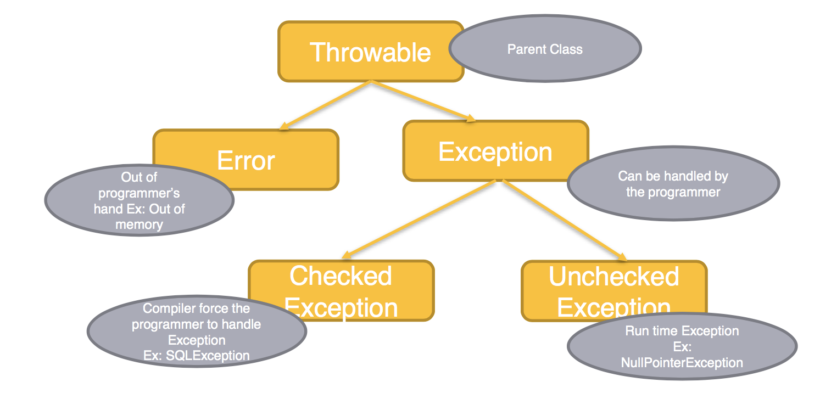
Exception in Nutshell
Non Recoverable
Recoverable
BCSC1002 Object Oriented Programming
Notes:
‹#›

Slide 14
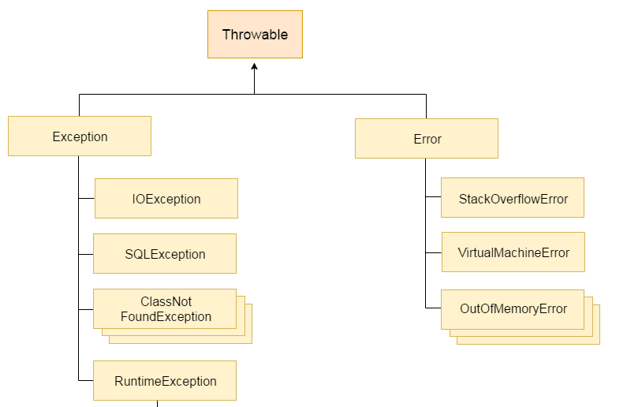
Java Exception Hierarchy
Root of Java Exception Hierarchy
BCSC1002 Object Oriented Programming
Notes:
‹#›

Slide 15
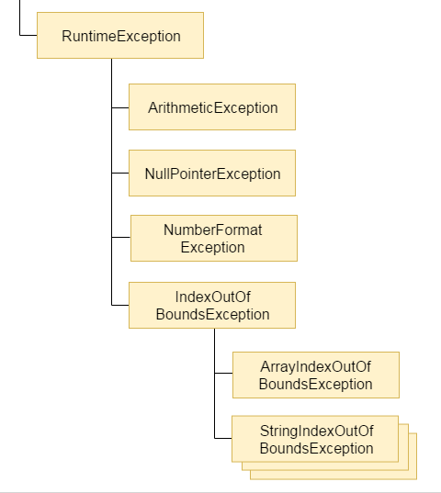
Java Exception Hierarchy (Contd.)
BCSC1002 Object Oriented Programming
Notes:
‹#›

Slide 16
Checked and Unchecked Exception
Exceptions which are checked by compiler for smooth execution of the program at runtime are considered as checked exception.
Example : FileNotFoundException
Exceptions which are not checked by the compiler whether programmer handling or not these exceptions are considered as unchecked exceptions
Example : Arithmetic Exception
BCSC1002 Object Oriented Programming
Notes:
‹#›

Slide 17
Checked and Unchecked Exception
Every exception occurs at runtime whether it is checked or unchecked.
RuntimeExceptions and its child classes, Error and its child classes are unchecked exception. Except these remaining are checked
BCSC1002 Object Oriented Programming
Notes:
‹#›

Slide 18
How to handle Exception?
Example:
public class ExceptionExample{
public static void main(String args[]){
try{
int res=50/0;
}
catch(ArithmeticException e)
{System.out.println(e);}
System.out.println("rest of the code...");
}
}
BCSC1002 Object Oriented Programming
Notes:
‹#›

Slide 19
Multiple Catch Statements
A single block of code can raise more than one exception
You can specify two or more catch clauses, each catching different type of exception
When an exception is thrown, each catch statement is inspected in order, and the first one whose type matches that of the exception is executed
After one catch statement executes, the others are bypassed, and execution continues after the try/catch block
BCSC1002 Object Oriented Programming
Notes:
‹#›

Slide 20
Multiple Catch Statements
Program with multiple catch blocks
import java.util.*;
class A{
public static void main(String args[]){
int a,b,result;
Scanner s=new Scanner(System.in);
System.out.println(“Enter Numerator and Denominator”);
try{
a=s.nextInt(); //InputMismatchException may occur
b=s.nextInt(); //InputMismatchException may occur
result=a/b; //ArithmeticException may occur
System.out.println(“Result:”+result); }
catch(ArithmeticException e)
{
System.out.println(“Cannot divide by zero”);
}
catch(InputMismatchException e)
{
System.out.println(“Only numbers are accepted”);
}//End of catch
}//End main
} //End class
BCSC1002 Object Oriented Programming
Notes:
‹#›

Slide 21
Assignment 1
Handle exception in number
Problem statement:
Get the input String from user and parse it to integer, if it is not a number it will throw number format exception Catch it and print "Entered input is not a valid format for an integer." or else print the square of that number. (Refer Sample Input and Output).
Sample input and output 1:
Enter an integer: 12
The square value is 144
The work has been done successfully
Sample input and output 2:
Enter an integer: Java
Entered input is not a valid format for an integer.
BCSC1002 Object Oriented Programming
Notes:
‹#›

Slide 22
Custom Exception
Example of custom Exception :-
class InvalidAgeException extends Exception
{
InvalidAgeException(String s)
{
super(s);
}
}
BCSC1002 Object Oriented Programming
Notes:
‹#›

Slide 23
Custom Exception (Contd.)
class TestCustomException1{
static void validate(int age)throws InvalidAgeException{
if(age<18)
throw new InvalidAgeException("not valid");
else
System.out.println("welcome to vote");
}
public static void main(String args[]){
try{
validate(13);
}catch(InvalidAgeException m){System.out.println("Exception occured: "+m);}
System.out.println("rest of the code...");
}
}
BCSC1002 Object Oriented Programming
Notes:
‹#›

Slide 24
Java Finally block
Java finally block is a block that is used to execute important code such as closing connection, stream etc.
Java finally block is always executed whether exception is handled or not.
Java finally block follows try or catch block.
The finally block will not be executed if program exits(either by calling System.exit() or by causing a fatal error that causes the process to abort).
BCSC1002 Object Oriented Programming
Notes:
‹#›

Slide 25
Assignment 2
Write a program that takes as input the size of the array and the elements in the array. The program then asks the user to enter a particular index and prints the element at that index.
This program may generate Array Index Out Of Bounds Exception. Use exception handling mechanisms to handle this exception. In the catch block, print the class name of the exception thrown.
Sample Input and Output :
Enter the number of elements in the array 3
Enter the elements in the array
20 90 4
Enter the index of the array element you want to access 2
The array element at index 2 = 4
The array element successfully accessed
BCSC1002 Object Oriented Programming
Notes:
‹#›

Slide 26
Quiz

Slide 27
Q. Consider the following code it is correct?
public class ExceptionDemo1 {
public static void main(String[] args) {
try
{
System.out.println(10/0);
}
catch(Exception obj)
{
obj.printStackTrace();
}
catch(ArithmeticException obj)
{
obj.printStackTrace();
}
System.out.println("End of the main method ");
}
}

Slide 28
Q. What will be the result, if we try to compile and execute the following code as:-
java ExceptionDemo1 100
public class ExceptionDemo1 {
public static void main(String[] args) {
try {
int i = Integer.parseInt(args[0]);
System.out.println(i);
}
System.out.println("Main method ");
catch(NumberFormatException e)
{
System.out.println(e);
}
}
}

Slide 29
Q. Is the following code legal?
try {
} finally {
}

Slide 30
Q. Consider the following code?
public class ExceptionDemo1
{
static ArithmeticException obj;
public static void main(String[] args)
{
throw obj;
}
}

Slide 31
Q. Consider the following code?
public class ExceptionDemo1
{
public static void main(String[] args) {
System.out.println("Main method Begins");
try
{
System.out.println(10/0);
System.out.println(args[2]);
}
catch(ArithmeticException | IndexOutOfBoundsException obj)
{
obj.printStackTrace();
}
System.out.println("End of the main method");
}
}

Slide 32
Q. Consider the following code?
public class ExceptionDemo1
{
public static void main(String[] args) {
System.out.println("Main method Begins");
try
{
System.out.println(10/0);
System.out.println(args[2]);
}
catch(ArithmeticException | Exception obj)
{
obj.printStackTrace();
}
System.out.println("End of the main method");
}
}

Slide 33
Q. Consider the following code? Is the following code legal?
public class ExceptionDemo1
{
public static void main(String[] args) {
try(Scanner obj = new Scanner(System.in))
{
System.out.println("hello");
}
}
}

Slide 34
Q. Predict the output of following Java program?
class Main {
public static void main(String args[]) {
try
{
throw 10;
}
catch(int e)
{
System.out.println("Got the Exception " + e);
}
}
}

Slide 35
Q. Predict the output of following Java program?
public class Test
{
public static void main(String[] args)
{
try
{
return;
}
finally
{
System.out.println( "Finally" );
}
}
}

Slide 36
Q. What will be the output of the program?
public class ExceptionTest
{
public static void main(String [] args)
{
try
{
badMethod();
System.out.print("A");
}
catch (RuntimeException ex)
{
System.out.print("B");
}
catch (Exception ex1)
{
System.out.print("C");
}
finally
{
System.out.print("D");
}
System.out.print("E");
} // end of the main method
public static void badMethod()
{
throw new RuntimeException();
}
} //end of class ExceptionTest

